Slide 1


Slide 2
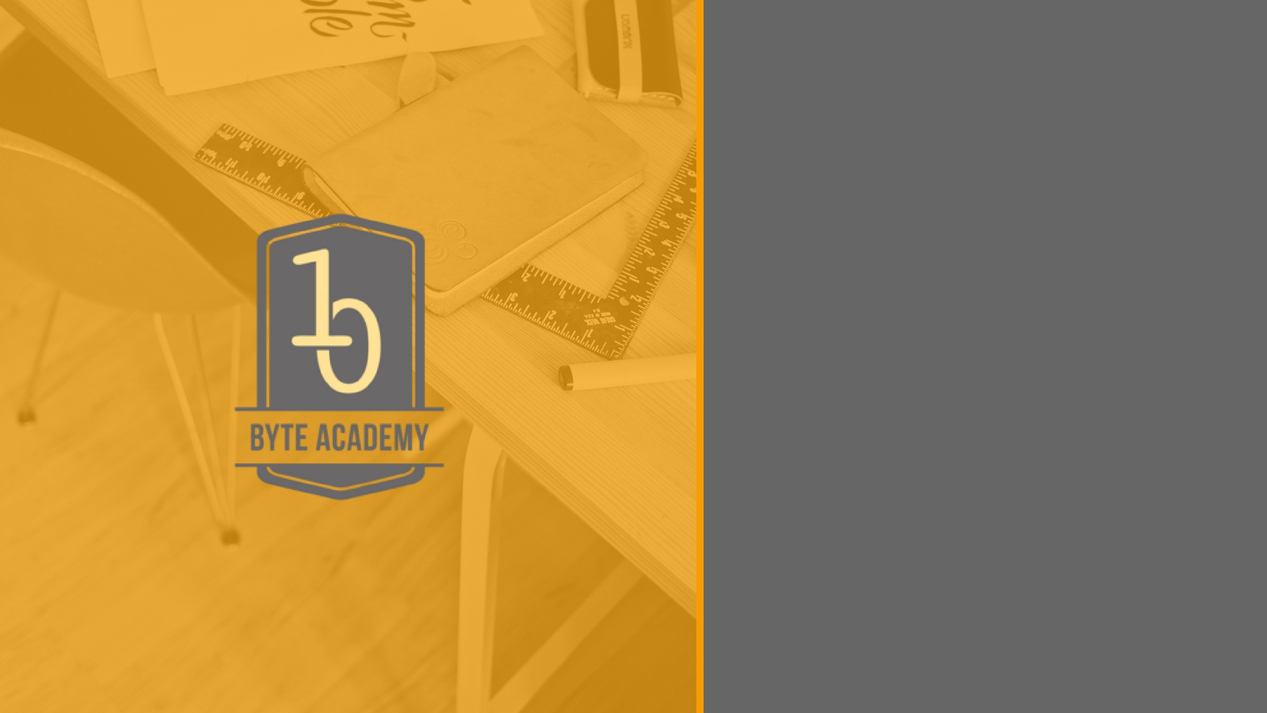
Introduction to Python AND
Python for Scientific Computing

Slide 3

Python: Some features
Python is a programming language, as are C, Fortran, BASIC, PHP, etc.
Some specific features of Python are as follows: 1) an interpreted language. Contrary to e.g. C or Fortran, one does not compile Python code before executing it.
2) In addition, Python can be used interactively: many Python interpreters are available, from which commands and scripts can be executed.
3) a very readable language with clear non-verbose syntax a language for which a large variety of high-quality packages are available for various applications, from web frameworks to scientific computing.

Slide 4
Python: Some features, continued
4) a language very easy to interface with other languages, in particular C and C++. 5) Python is an object-oriented language, with dynamic typing (the same variable can contain objects of different types during the course of a program).

Slide 5
Python Numeric Data Types
-Integer
e.g (1,4,2)
- Floating point (decimal)
e.g (1.32,15.234324)
- Complex numbers
e.g (a+bi = 1 + .5j)
-Booleans
only two values (True or False)

Slide 6
Built-in Collection Types
Lists: A list is an ordered, mutable collection of zero or more references to Python data objects. Lists are written as comma-delimited values enclosed in square brackets. The empty list is simply [ ].
Lists are heterogeneous, meaning that the data objects need not all be from the same class and the collection can be assigned to a variable as below.

Slide 7
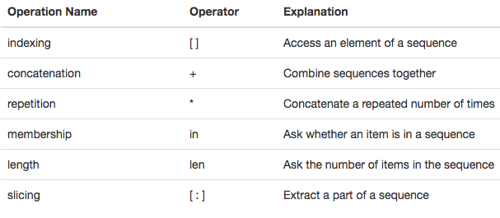
Operations on Lists

Slide 8
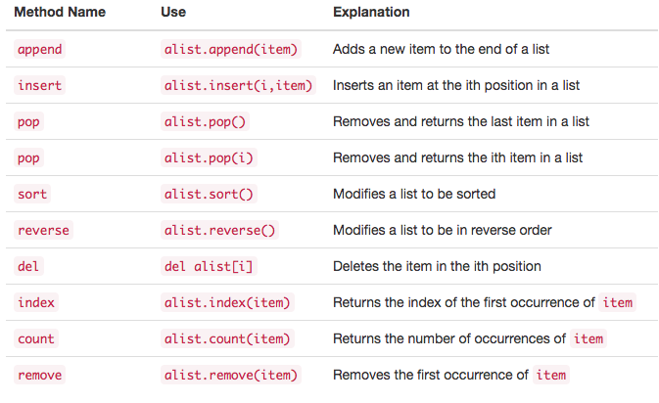
List Methods
A method is a function that “belongs to” an object

Slide 9
Strings
Strings are sequential, immutable, collections of zero or more letters, numbers and other symbols. We call these letters, numbers and other symbols characters. String values are differentiated from identifiers by using quotation marks (either single or double).
The operations on Lists and strings are exactly the same EXCEPT that strings are immutable and cannot be modified. To modify a string, the .replace() method must be used an must be set to another variable.

Slide 10
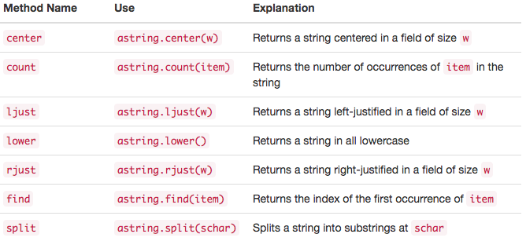
String Methods
Slide Contents

Slide 11
Tuples
Tuples are very similar to lists in that they are heterogeneous sequences of data. The difference is that a tuple is immutable, like a string. A tuple cannot be changed. Tuples are written as comma-delimited values enclosed in parentheses.

Slide 12
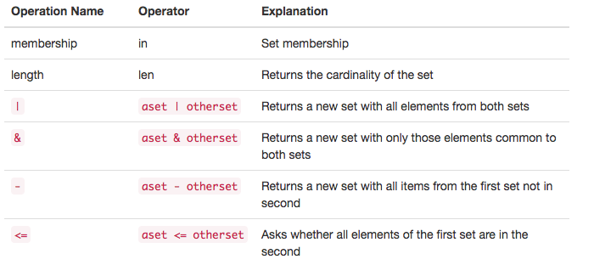
Sets
A set is an unordered collection of zero or more immutable, unique, Python data objects. Sets do not allow duplicates and are written as comma-delimited values enclosed in curly braces.

Slide 13
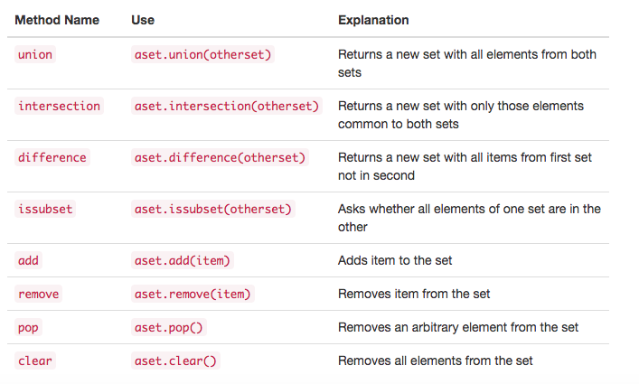
Set Methods

Slide 14
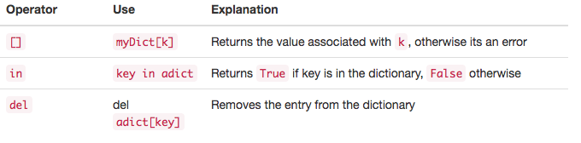
Dictionaries
Dictionaries are unordered collections of associated pairs of items where each pair consists of a key and a value. This key-value pair is typically written as key:value.

Slide 15
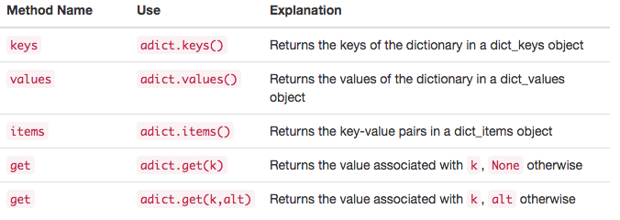
Dictionary Methods
Slide Contents

Slide 16
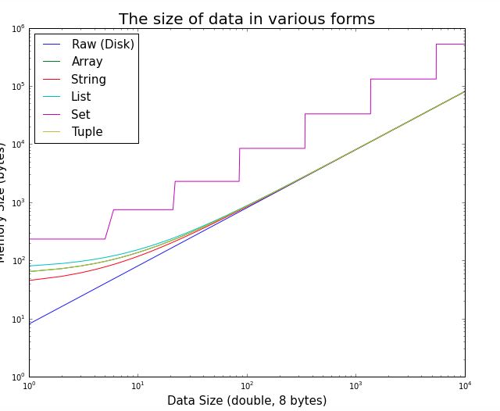
Relative Memory Efficiency
Notes:
Tuples, being immutable, are more memory efficient; lists, for efficiency, overallocate memory in order to allow appends without constant reallocs. So, if you want to iterate through a constant sequence of values in your code (eg for direction in 'up', 'right', 'down', 'left':), tuples are preferred, since such tuples are pre-calculated in compile time. Access speeds should be the same (they are both stored as contiguous arrays in the memory). But, alist.append(item) is much preferred to atuple+= (item,) when you deal with mutable data. Remember, tuples are intended to be treated as records without field names.

Slide 17


